Slide 1
Online shoppers’ intention
prediction
By Thai Linh Bui

Slide 2
Table of contents
Dataset presentation
Data cleaning and Exploratory Data Analysis
Prediction Models
Learning & Improvements

Slide 3
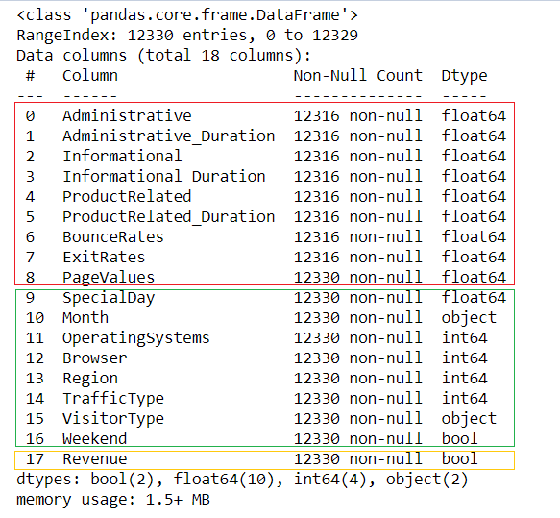
Dataset presentation
Source: Kaggle
12 330 rows and 18 columns:
9 numerical features
8 categorical features (string or numerical values)
1 target feature (boolean) : True = Buy, False = Not Buy
1 row = 1 session belonging to 1 user
1-year period

Slide 4
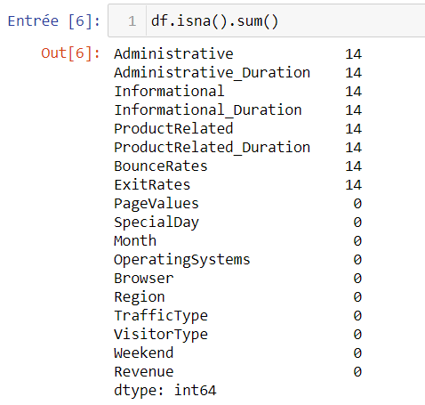
2. Data cleaning and EDA
Data Cleaning
Drop missing values (14 rows)

Slide 5
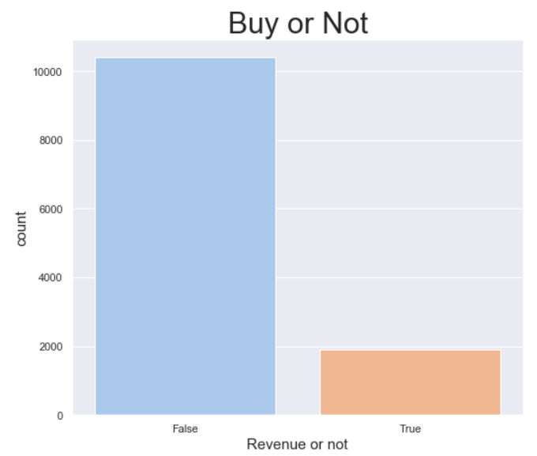
2. Data cleaning and EDA
EDA
Uni-Variate Analysis - Categorical features
Observation: Imbalanced dataset
Target feature distribution

Slide 6
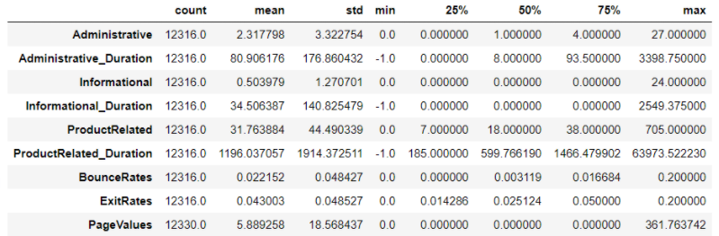
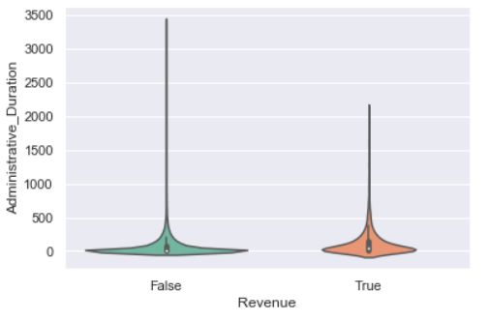
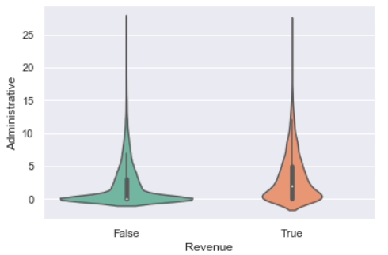
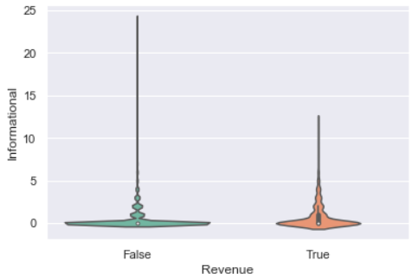
2. Data cleaning and EDA
EDA
Bi-Variate Analysis - Numerical Features
9 Numerical features
Not really follow the normal distribution
Outliers detected
Example:

Slide 7

3. Prediction Model
3.1 Preparation
Create dummies columns for the categorical features:
increase of number of columns from 18 to 73 columns

Slide 8
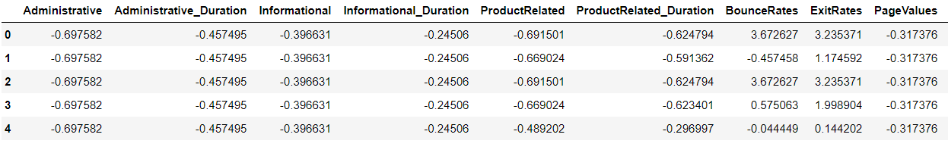
3. Prediction Model
3.1 Preparation
Dealing with the outliers of numerical features
Scaling the dataset:

Slide 9
3. Prediction Model
3.2 Model Selection and Process of testing
Decision Trees KNN
Random Forest Logistic Regression
Adaboost SVC
XGB GaussianNB
Catboost

Slide 10
3. Prediction Model
3.2 Model Selection and Process of testing
1st run
Standardized dataset
2nd run
With PCA
3rd run
With Undersampling & PCA
4th run
With Smote resampling & PCA

Slide 11
3. Prediction Model
3.3. Result
1st Run
- Accuracy scores: [83.7% , 84.6%], except for the GaussianNB : 24.4%.
Decision trees = 1st position
- Recall: very low rate (<8%), except for the GaussianNB : 95.8%
- Precision: range of [16% , 60%]. Highest rate = 60.8% - Random Forest
- All models are quite successful in predicting the False outcome (not Buy) but they fail to predict the True outcome (Buy) due to the imbalanced dataset, except for the GaussianNB.

Slide 12
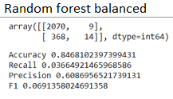
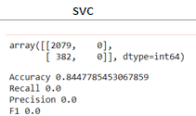
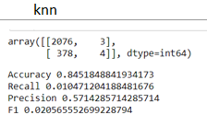
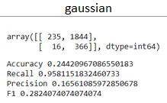
3. Prediction Model
3.3. Result
1st Run
Example:

Slide 13
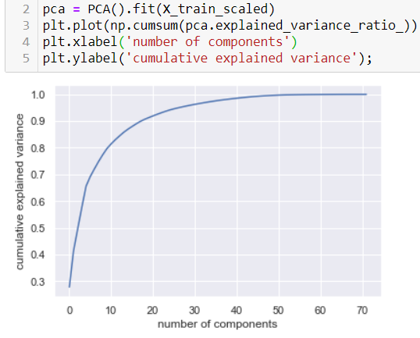
3. Prediction Model
3.3. Result
2nd Run with PCA
From the original features, PCA selects the principal components explaining the majority of the variance of data.
Aim: reduce the number of features, improve the result
Select 17 components explaining 90% the variance

Slide 14
3. Prediction Model
3.3. Result
2nd Run with PCA
Result:
Accuracy scores:
quite similar to the ones of the first run
in the range of [83.1% , 84.6%]
The recall rates: still low (<6%)
Precision rate: Catboost = highest rate (60.9%)
The PCA impacts the most on the result of GaussianNB:
accuracy score: 24% -> 83.4%.
Recall score: 95.6% -> 3%

Slide 15
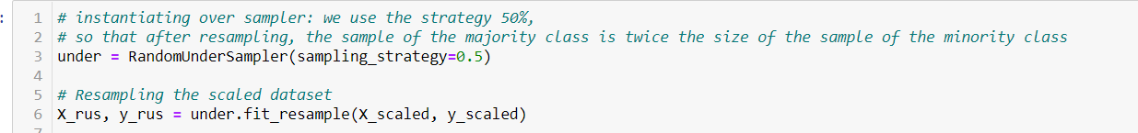
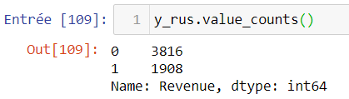
3. Prediction Model
3.3. Result
3rd Run with Random Undersampling and PCA
Solution for the imbalance between the classes of the target feature:
Seek to randomly select and remove samples from the majority class
Sampling strategy: 50%
Notes:
The sample of the majority class is twice the size of the sample of the minority class

Slide 16
3. Prediction Model
3.3. Result
3rd Run with Random Undersampling and PCA
Result vs 2nd run:
Accuracy score: decreases from 83% to 64%: range [64.6% , 66.9%]
Highest score: Logistic Regression
Recall score: improved from lower than 8% to the range [12.3% , 34.8%]
Highest score: Decision Tree
Precision score: improved for all models - range [44% , 51%]
Notes:
The sample of the majority class is twice the size of the sample of the minority class

Slide 17
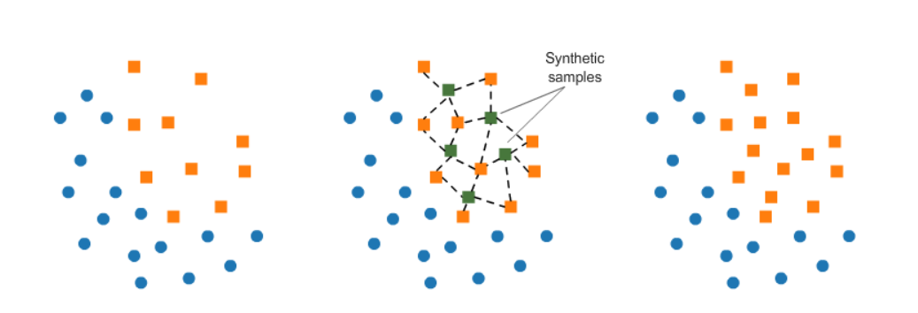
3. Prediction Model
3.3. Result
4th Run with Smote resampling and PCA
Smote resampling: oversampling the minority by:
Picking points from the minority class and computing the k-nearest neighbors for each of these points
Adding synthetic points between each chosen point and its neighbors

Slide 18
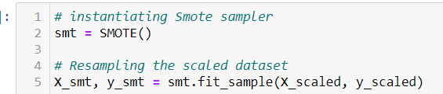
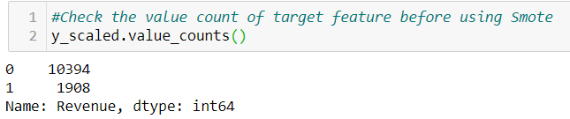
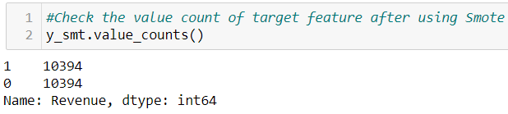
3. Prediction Model
3.3. Result
4th Run with Smote resampling and PCA
Smote resampling:
Notes:
Both categories have equal amount of records. More specifically, the minority class has been increased to the total number of majority class

Slide 19
3. Prediction Model
3.3. Result
4th Run with Smote resampling and PCA
Result vs 3rd run:
Accuracy score: higher than 3rd run for most of model - range [64.8% , 82%]
Highest rate: Random Forest
Recall score: much higher - range [63% , 91%]
Highest rate: KNN
Precision score: much higher - range [63% , 80.6%]
Highest rate: Random Forest
Notes:
Both categories have equal amount of records. More specifically, the minority class has been increased to the total number of majority class

Slide 20
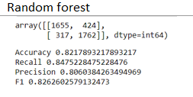
3. Prediction Model
3.3. Result
Conclusion
Combination between Smote and PCA gives the best model: Random Forest

Slide 21
Github
https://github.com/EricBui0201/Online_Shoppers_Intention_Prediction

Slide 22
Thank you :)

